Slide 1
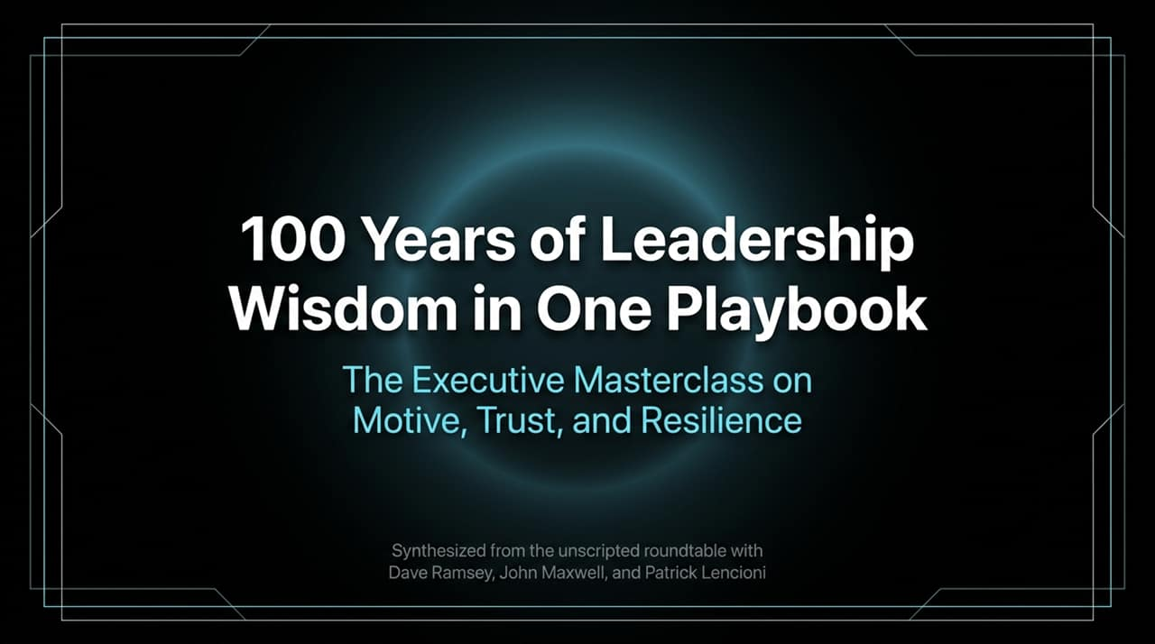
Notes:
https://youtube.com/watch?v=r9eOy5riCxU
Opening Hook: "Welcome, everyone. Today, we aren't just discussing management theory—we are looking at the culmination of a century’s worth of practical leadership wisdom distilled from three titan figures: Dave Ramsey, John C. Maxwell, and Patrick Lencioni."
Core Theme: "At the executive level, leadership is rarely a technical challenge; it is a human and strategic one. This masterclass centers on three pillars: Motive, Trust, and Resilience."
Takeaway: "By the end of this session, you will have actionable mental models to transform how you lead your executive teams, evaluate potential, and handle conflict."

Slide 2
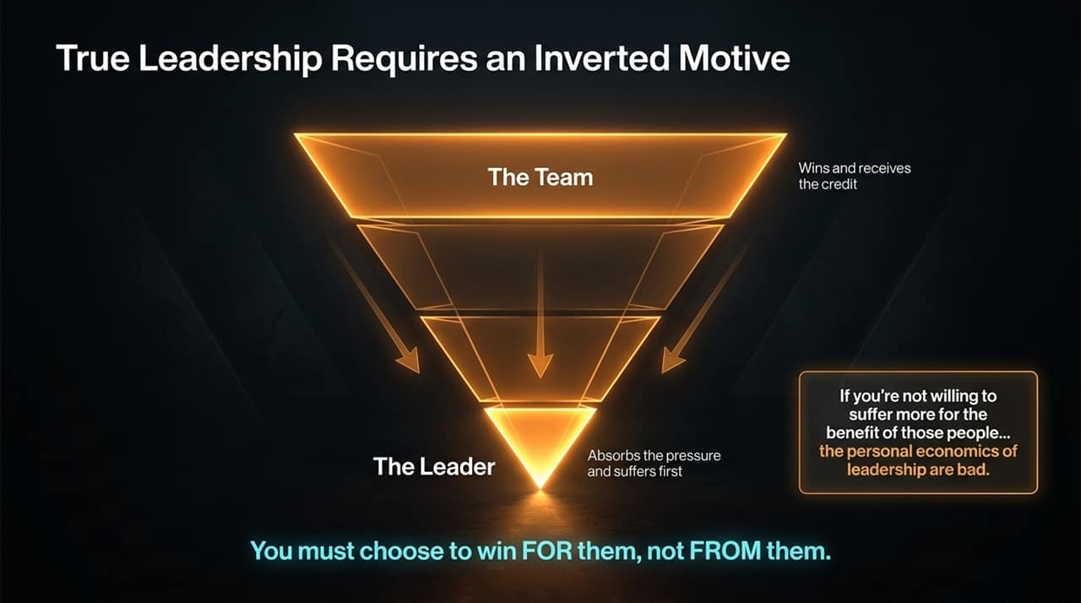
Notes:
The Paradigm Shift: "Look at this inverted pyramid. Traditional management views leadership as a pedestal—where status, compensation, and credit flow up to the leader. Real leadership flips the pyramid upside down."
Absorbing Pressure: "As an executive, your role is to absorb organizational pressure and suffer first so your team can perform freely. When things go right, the credit goes up to the team. When things go wrong, the burden stays at the bottom with you."
The Core Rule: "You must choose to win for your team, not from them. If you view leadership as a vehicle for personal gain, the personal economics of leadership are fundamentally flawed."

Slide 3
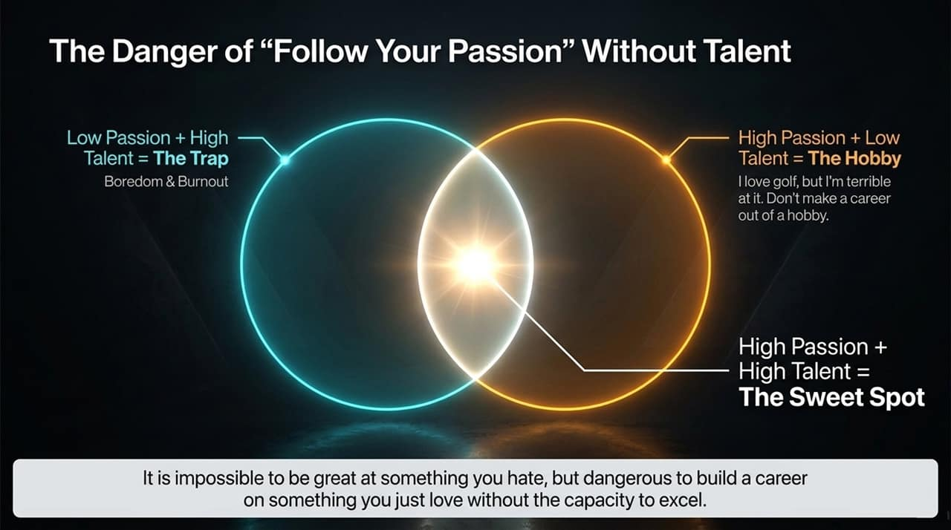
Notes:
Debunking the Myth: "We’ve all heard the advice 'follow your passion.' But passion without talent is a trap."
quadrant breakdown:
High Talent + Low Passion: Leads to boredom and eventual burnout.
High Passion + Low Talent: That's a hobby. 'I love golf, but I'm terrible at it.' Don't make a career out of a hobby.
High Passion + High Talent: The Sweet Spot.
Executive Insight: "It is impossible to be great at something you hate, but it is equally dangerous to build an enterprise or promote someone based purely on enthusiasm without verified competency."

Slide 4
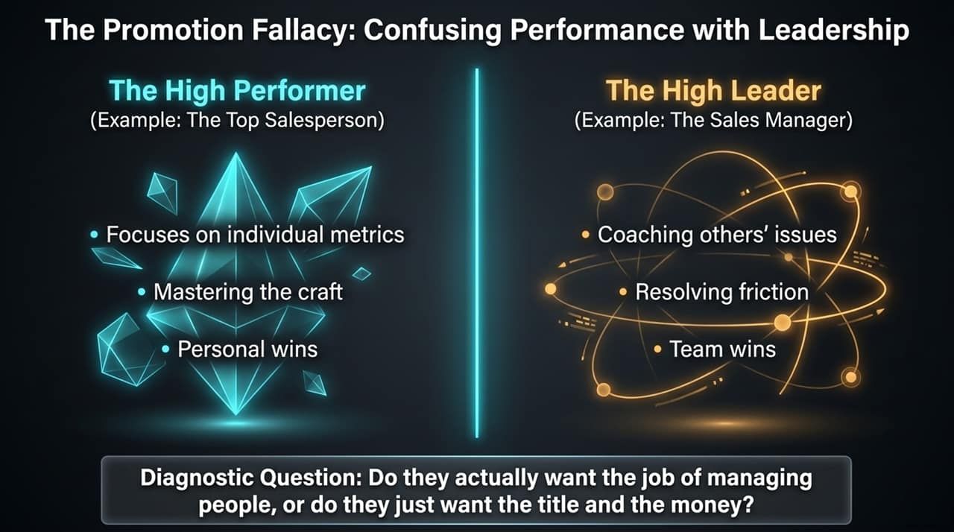
Notes:
The Trap: "One of the most common organizational mistakes is promoting your top individual performer—like your #1 salesperson—into management, only to lose a great producer and gain a miserable manager."
The Distinction:
High Performers: Focused on individual metrics, personal mastery, and individual wins.
High Leaders: Focused on coaching, eliminating organizational friction, and building team wins.
Diagnostic Tool: "Ask yourself before every promotion: Do they actually want the job of managing people, or do they just want the title, status, and money?"

Slide 5
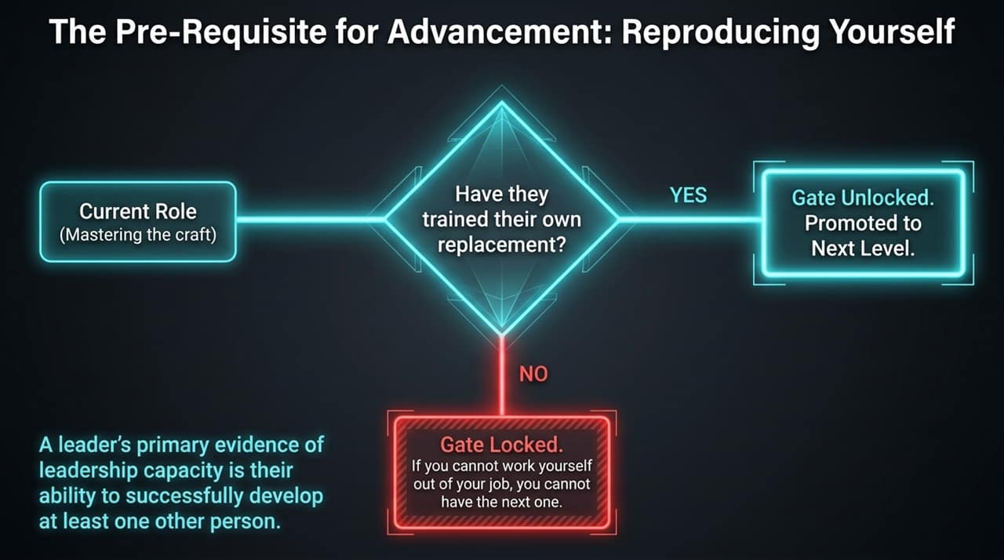
Notes:
The Rule: "You cannot advance if you are irreplaceable in your current seat—because replacing you would break the operational chain."
The Gatekeeper Mechanism: "The ultimate prerequisite for promotion is training your replacement. If 'Gate = Yes' (they have mentored and equipped a successor), the promotion gate unlocks."
Takeaway: "A leader's primary evidence of capacity is not their own output, but their ability to successfully develop at least one other person to take their place."

Slide 6
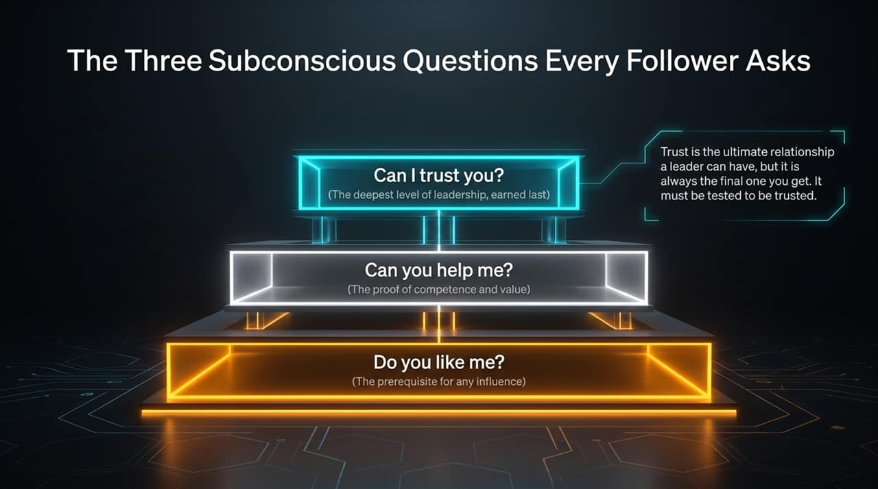
Notes:
Psychological Hierarchy: "Every team member is constantly running a subconscious evaluation of their leader across three core questions:"
Do you like me? (Prerequisite for influence—people must feel valued).
Can you help me? (Competency and capability to guide them).
Can I trust you? (The apex—fundamental character and alignment).
Executive Reality: "Trust is the ultimate capital a leader can hold, but it is earned last and must be continuously tested to remain valid."

Slide 7
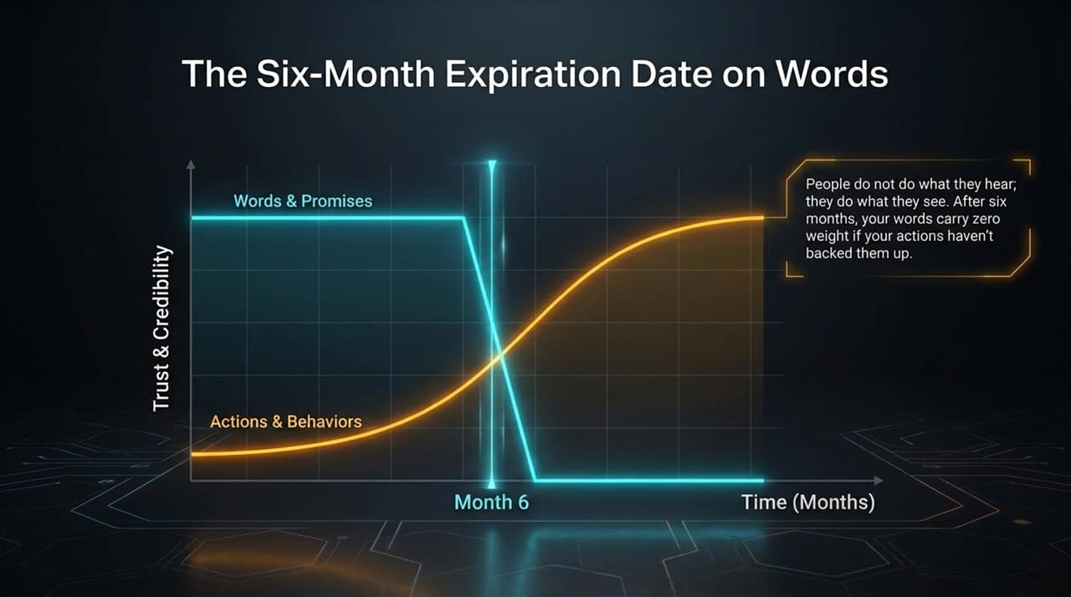
Notes:
The Graph: "When you take on a leadership position or announce a strategic shift, your words and promises carry high initial credit. But look at Month 6."
The Tipping Point: "At the six-month mark, the weight of words plummets to zero if not backed by consistent behavior. Actions and tangible results take over completely."
Key Principle: "People don't do what they hear; they do what they see. Your words buy you six months; your actions define your legacy."

Slide 8
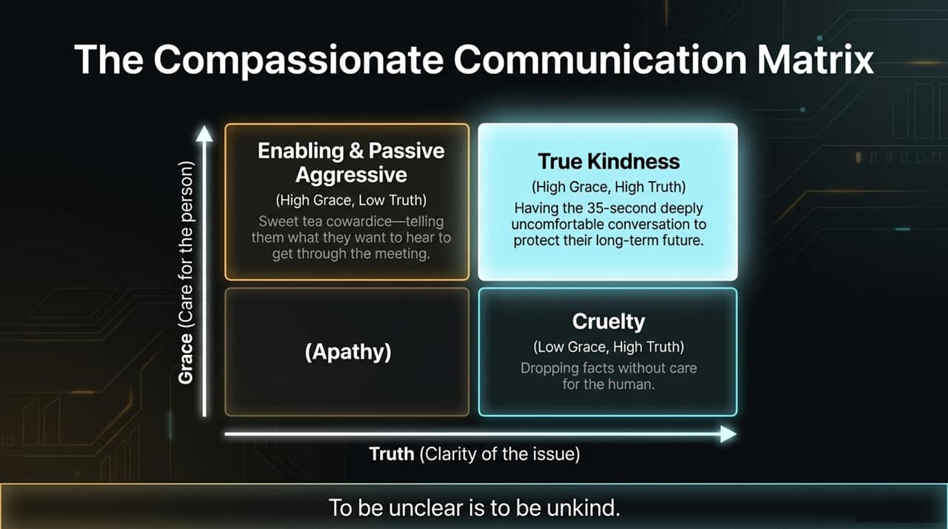
Notes:
The Matrix Axes: "Effective executive communication requires balancing two dimensions: Grace (Care for the person) and Truth (Clarity of the issue)."
4 Quadrants:
Low Grace / Low Truth: Apathy.
Low Grace / High Truth: Cruelty—dropping facts like weapons without empathy.
High Grace / Low Truth: Enabling & Passive Aggressiveness—'Sweet tea cowardice' where you sugarcoat issues to avoid discomfort.
High Grace / High Truth: True Kindness.
Mantra: "To be unclear is to be unkind. Have the uncomfortable 35-second conversation today to protect their long-term future."

Slide 9
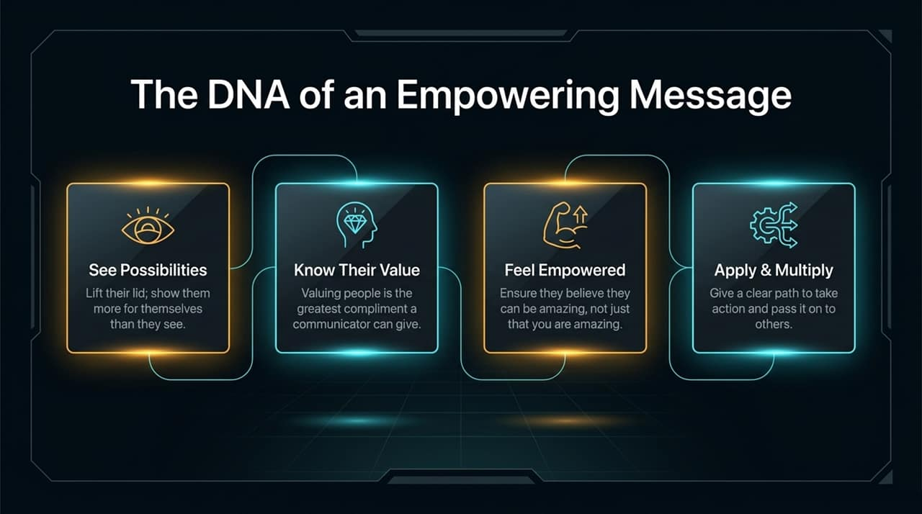
Notes:
Process Flow: "To deliver messages that move teams into action, follow this four-stage DNA sequence:"
See Possibilities: Expand their vision beyond their current self-imposed limits.
Know Their Value: Communicate their inherent worth to the team.
Feel Empowered: Ensure they believe they can achieve it, rather than just admiring your ability.
Apply & Multiply: Provide actionable steps so they can pass leadership skills on to others.

Slide 10
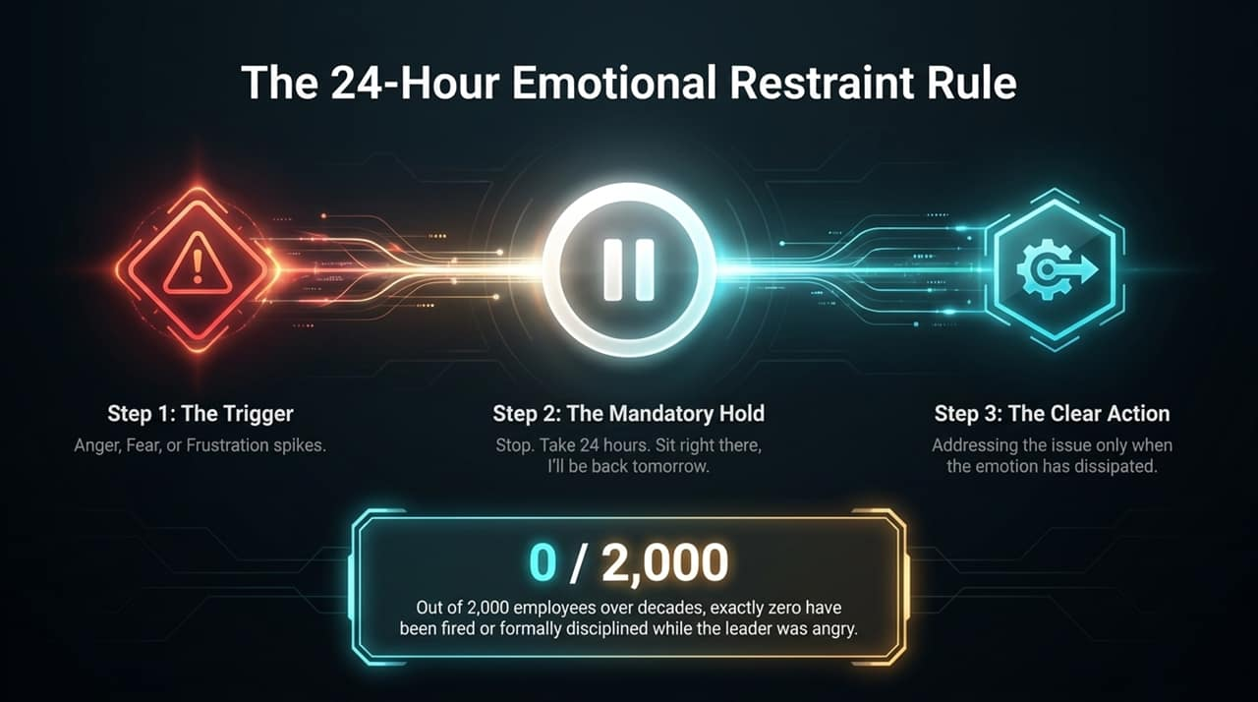
Notes:
The Protocol: "When anger, frustration, or fear spikes after a major mistake or breach:"
Step 1: Recognize the trigger.
Step 2: Apply a mandatory 24-hour hold. Do not fire, discipline, or send impassioned emails.
Step 3: Execute clear action only after emotional emotion has dissipated.
The Metric: "In top-tier organizations built on trust, out of thousands of employees over decades, 0 out of 2,000 were ever disciplined or terminated while the leader was actively angry."

Slide 11
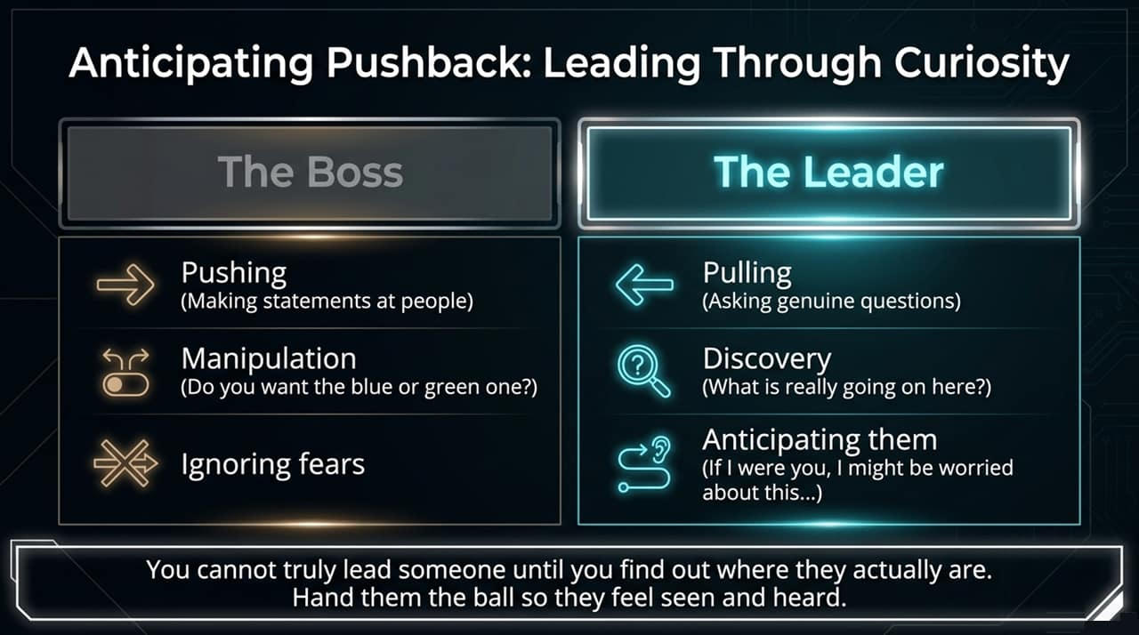
Notes:
Boss vs. Leader:
The Boss: Pushes, makes blunt statements, uses false choices/manipulation, and ignores underlying fears.
The Leader: Pulls by asking genuine questions, seeks root causes ('What is really going on here?'), and proactively speaks to unstated fears.
Actionable Advice: "You cannot lead someone until you meet them where they actually are. Pre-empt their concerns by saying: 'If I were in your shoes, I might be worried about X...' Hand them the ball so they feel understood."

Slide 12
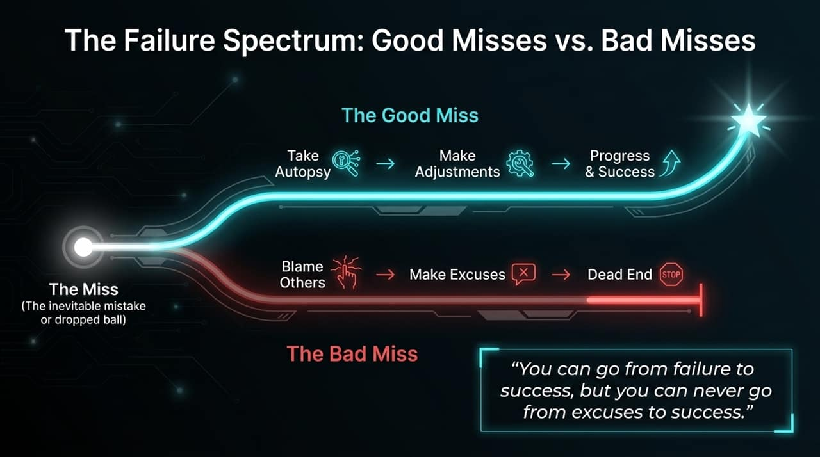
Notes:
The Fork in the Road: "When a miss or mistake occurs, organizations split into two paths:"
The Good Miss: Conduct an objective autopsy $\rightarrow$ Make data-backed adjustments $\rightarrow$ Achieve long-term success.
The Bad Miss: Blame others $\rightarrow$ Make excuses $\rightarrow$ Hit an organizational dead end.
Golden Rule: "You can go from failure to success, but you can never go from excuses to success."

Slide 13
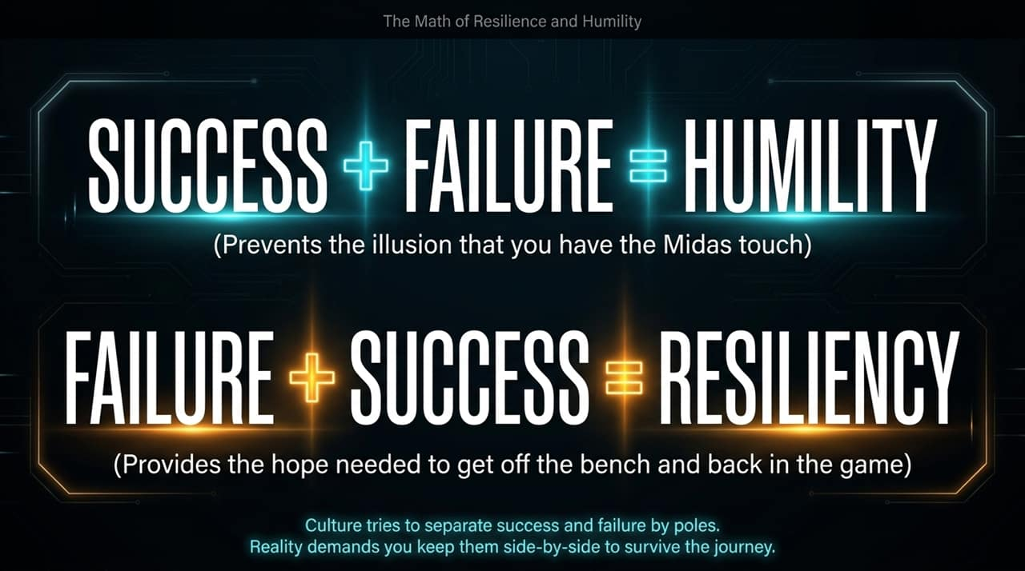
Notes:
Speaker Script & Key Talking Points
Equational Thinking:
$\text{SUCCESS} + \text{FAILURE} = \textbf{HUMILITY}$
$\text{FAILURE} + \text{SUCCESS} = \textbf{RESILIENCY}$
Core Meaning: "Success paired with awareness of potential failure prevents ego and the illusion of the 'Midas touch.' Failure paired with past success provides the hope needed to get back up."
Insight: "Corporate culture tries to separate success and failure into opposing poles. High-performing leaders keep them side-by-side."

Slide 14
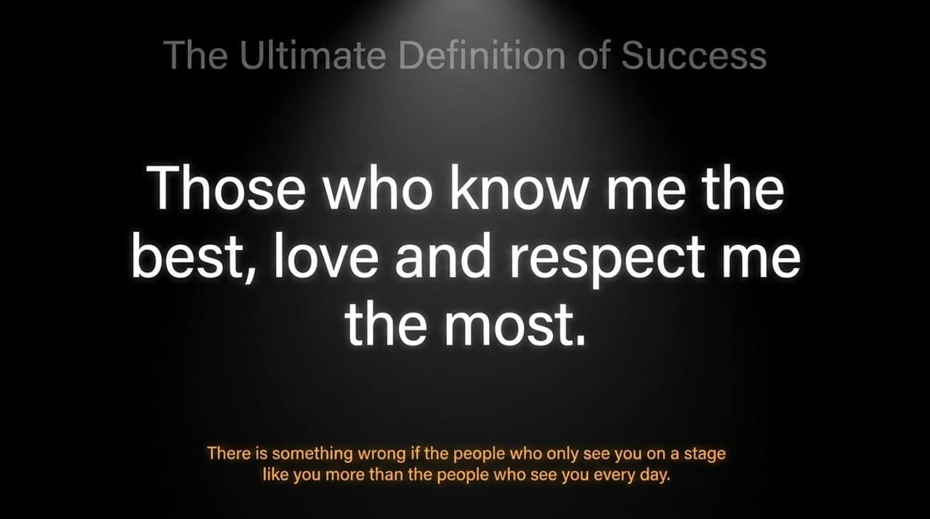
Notes:
The Metric of Character: "The ultimate benchmark of executive success is simple: Those who know me the best, love and respect me the most."
The Warning: "If the public, board, or casual acquaintances admire you more than your immediate team, family, and direct reports, your leadership is built on a facade."
Reflection: "Internal character must always outweigh external reputation."

Slide 15
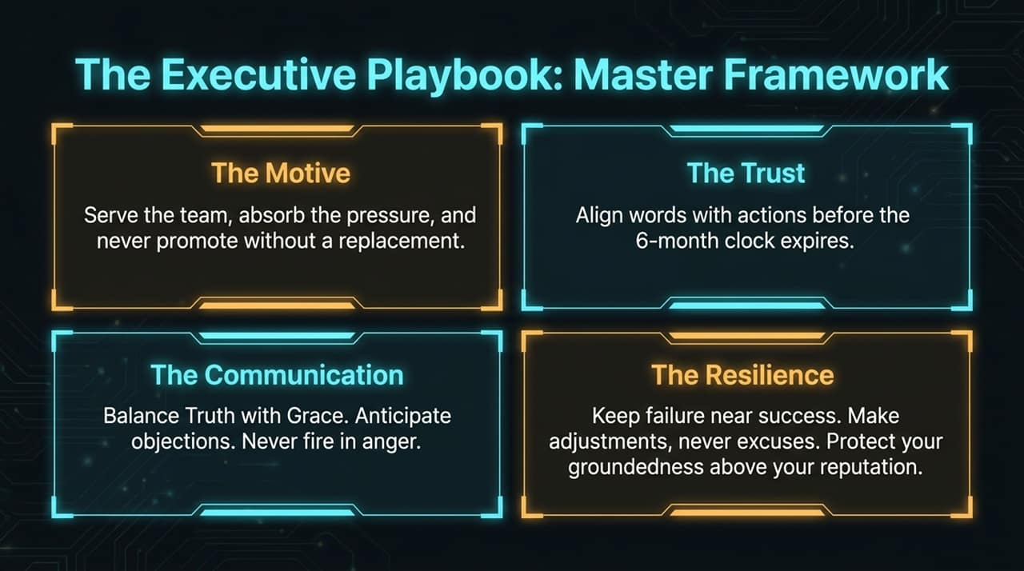
Notes:
Summary of Core Pillars:
1. The Motive: Serve the team, absorb pressure, and enforce 'reproduce before promote.'
2. The Trust: Match words with execution before the 6-month credibility clock runs out.
3. The Communication: High Truth + High Grace. Enforce the 24-hour emotional restraint rule.
4. The Resilience: Treat mistakes as autopsies, reject excuses, and anchor character internally.

Slide 16
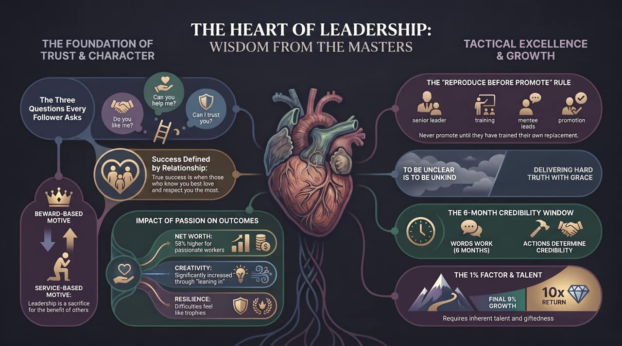
Notes:
Closing Synthesis: "This visual map brings our entire framework together—uniting character foundation on the left with tactical execution on the right."
Final Call to Action: "As executive leaders, leadership is an act of stewardship. Lead with inverted motives, communicate hard truths with grace, and build leaders who can step into your shoes."

